Slide 1
Friday, October 28, 2016
Write In Your Agenda:
Write In Your Monitoring Log:
CW:
Earthquake Quiz Study Guide
An Inside Look at the San Andreas Fault
Monitoring Earthquakes
HW:
Study for Earth Quiz on Thursday.
Response to Warm-Up:
What was the most difficult part of the Mercalli and Me! Activity for you?
You will need:
Pencil

Slide 2
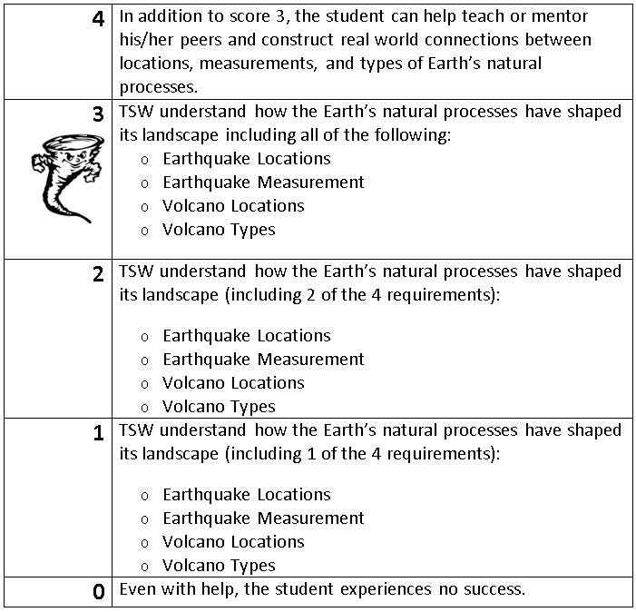
Learning Goal and Scale
TSW understand how the Earth’s natural processes have shaped its landscape (including Earthquake locations and how they are measured as well as Volcano locations and the three types).

Slide 3
Friday, October 28, 2016
Read An Inside Look At The San Andreas Fault.
Answer both sides of worksheet.
Hand in when finished

Slide 4
Friday, October 28, 2016
Read pages 178-183 in science book.
Complete both sides of Monitoring Earthquakes worksheet.
Hand in when finished.

